Slide 1
NextGen Sequencing BIFX-550
Relevant Book Chapter is 9
S. Ravichandran, Ph.D. Biology,
Hood College, Frederick, MD 21701

Slide 2
How does sequencing work?
DNA
Create fragments
Reads
Measurement can result in the reads of same length or shorter
Or longer when retained with adapters
Mostly the instrument knows the adapters (at the 5’ end but not the 3’ end) and skips them
XXXXGGGGTTTTYYYY
Red font indicate adapters

Slide 3
Alignment
Collection of short DNA pieces called library
Short DNA is called fragment (F ~ 450 bp)
Each segment can be sequenced
One end or both ends (Paired-End Sequencing)
HiSeq or MiSeq (instruments that can do PES)
Famous aligner is called BWA

Slide 4
Adapters
Illumina Universal Adapter AGATCGGAAGAG
Illumina Small RNA 3' Adapter TGGAATTCTCGG
Illumina Small RNA 5' Adapter GATCGTCGGACT
SOLID Small RNA Adapter CGCCTTGGCCGT
You don’t want adapters in your reads.
Software packages are available to trim them
Trimmomatic

Slide 5
Sequencing will be done on both strands
Size distribution of the reads can vary (typically 25-50 bp)
Paired-end Sequencing
Method to sequence both ends of a fragment and to make the pairing information available
Illumina PE sequencing
The two reads are stored in separate files (fastq)
First step “single end reads”
----->
AAAATTTTGGGGCCCC
Then the sequence is flipped and reverse complemented and a second measurement is taken
----->
AAAATTTTGGGGCCCC
TTTTAAAACCCCGGGG
<-------

Slide 6
Sequencing Instruments
Illumina, MiniSeq, MiSeq, NextSeq, HiSeq
Undisputed leader in HTS
Up to 300M reads
Up to 1500 GB/run (GB: 1 Billion bases)
IonTorrent, PGM, Proton
Up to 400 bp long reads; Up to 12 GB/run
PacBio Sequel
Specialized in long-read sequencing
Up to 12,000 long paired-end reads; up to 4 GB/run

Slide 7
Sequencing outputs
Sequencing runs outputs
Gzip compressed FASTQ files/sample
# of samples = # of FASTQ files
Raw data
Usually submitted to NCBI SRA db
Sequencing Coverage?
# measurements (on average) will be carried out on base of the genome
10x means each base on average sequenced 10 times

Slide 8
Miscellaneous
Typical coverages for DNA sequencing
Genome assembly ~ 50x & above
Variation calling ~ 20x & above
RNA
Since different transcripts are expressed at different levels, no common measure is available
C = # of sequenced bases/total-genome-size
There are other methods available (not covered)

Slide 9
Miscellaneous
Note in an expt not all bases will be sequenced. There is a theoretical formula to calculate this measure
Lander/Waterman model

Slide 10
NGS Reads
SRA (Short Read Archive)
Very convoluted, unfriendly database
Each Bioproject; PRJNA616147
NCBI Biosample SAMN14483190
Source of the sample
SRA experiment; SRX8023307
SRA Run; SRR11445485
Data files linked to a given experiment
COVID-19 virus
More than one can be available

Slide 11
NGS Reads
SRA
How can I download data?
SRA-toolkit
ENA (SRA equivalent)
HANDS ON IN HOOD CLUSTER
What is a spot?

Slide 12
FASTQ
@ID length=5
GTCCA
+ID length=5
CBCFF
Let us calculate Q scores (SANGER) for the first read
ASCII codes for CBCFF are 67, 66, 67, 70, 70
Take each ASCII # subtract 32
Use that number from a in the following formula
Q scores
67 → 35 → 10^(-3.5) → 0.03% (prob of error)
Here is an example of a file with 1 read
Fist line ID
Second line read letters
Third line id
Fourth line Quality measure

Slide 13
FASTQC
Tool (analysis/plots are not intuitive) to analyze the quality of reads
Use Galaxy to do a sample QC analysis
Note that FASTQC only visualizes/analyzes the QC doesn’t carry out QC on the reads
How does this work?
FASTQC takes a sample and carry out the analysis to make predictions

Slide 14
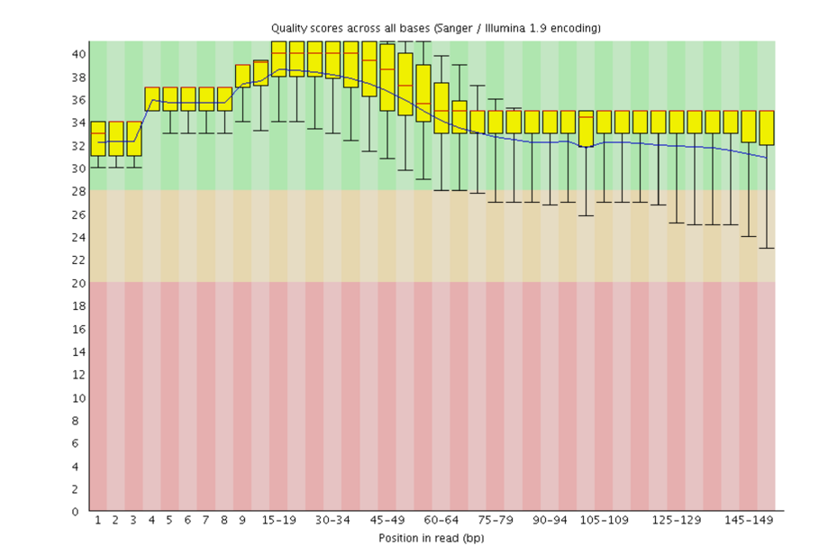
GOOD
BAD
WORSE

Slide 15
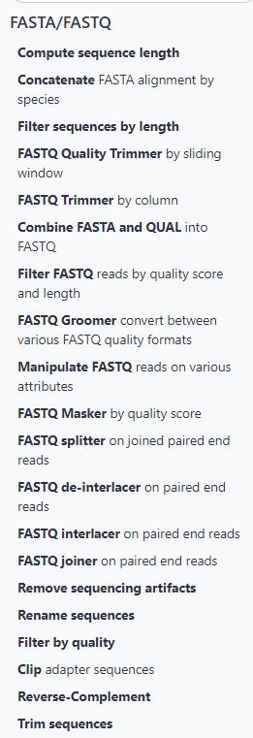
After QC what steps?
Visual evaluation of QC (FASTQC)
Move to next step if everything is fine. If not remove data that is bad and move to previous step
QC tools
Trimmomatic, BBDuk, cutadapt

Slide 16
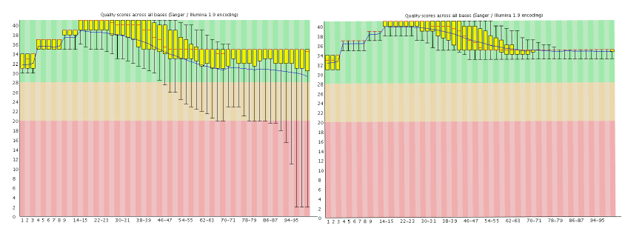
Trimmomatic; trimming the reads

Slide 17
SAM/BAM
SAM
Aligned file
Different formats
BAM
Binary version of SAM
SAMtools can be used to view BAM file alignments

Slide 18
Learning Objectives
Eukaryotic Chromosome
We will talk about DNA Sequencing.
How NGS data is generated?
What are FASTQ,SAM/BAM and VCF file formats?
How NGS data is aligned to a reference genome?
Genetic variants and how are they determined?
Types of errors associated with alignment
Impact assessment of genomic variants

Slide 19
Sequencing
Human Genome Project
Shotgun
https://www.youtube.com/watch?v=vg7Y5EeZsjk
Other sequencing
Genome Wars
Craig Venter (Celera founder, J. Craig Venter Institute)
Francis Collins (NIH Director)

Slide 20
NGS Applications
Whole genome sequencing for any species
Build or rebuild the tree of life
HGP (mosaic)
We can re-sequence the individual's genome
Genomes from individual cells within an individual
Cancer to non-cancerous cells
Somatic not sex cells

Slide 21
Sanger Sequencing

Slide 22
Basic Steps
Dideoxynucleotide sequencing
Obtain a template (DNA)
Denature to get a single strand DNA
Primer (20 nts complementary to the strand being sequenced)
DNA Polymerase
4 dNTPs

Slide 23
2′-deoxynucleotides (dNTPs) for extension, For example, 2′-deoxythymidine triphosphate dideoxynucleotide (ddNTP) for inhibition. For example, 2′,3′-dideoxythymidine triphosphate

Slide 24
This was initially used in the HGP (more on this later)
No 3-OH group, so extension will halt

Slide 25
Sanger Sequencing Pre next-gen or First-gen sequencing
Sequencing Reaction
DNA chain grow only from 3’ end
5’ GTACGG ..3’
Primer
3’ CATGCCATCGGGGCATGG ..5’ Template
Fluoresenct Labelled for ddNTP (chain terminating) nucleotides
dATP
A
dCTP
DNA Polymerase
C
T
A
T
A
A
G
C
A
C
G
A
A
A
T
C
T
C
C
T
Free Bases
C
A
C
A
A
G
C
T
A
A
G
G
C
T
A
G
C
T

Slide 26
ddCTP focused reaction
3’- CATGCCATCGGGGCATGG -5’ Template
5’- GTACGG -3’
Primer
DNA chain grow only from 3’ end
5’- GTACGGTAGC -3’ 5’- GTACGGTAGCC -3’
5’- GTACGGTAGCCC -3’
5’- GTACGGTAGCCCCGTAC -3’ 5’- GTACGGTAGCCCCGTACC -3’
If you are using ddCTP dideoxyribonucleic nucleotide triphosphate These are chain-terminating nucleotides. Once added they cannot extend the chain

Slide 27
Sequencing Reaction Products
GTACGGT
GTACGGTA
PRIMER 5’ GTACGG 3’
GTACGGTAG
dNTPs
GTACGGTAGC
G
C
PLUS Free Bases
A
T
GTACGGTAGCC
GTACGGTAGCCC
Handle 500-800 bases long
Sequencing runs out of steam roughly after about 800 bases.
3’ -CATGCCATCGGGGCATGG- 5’
-
DNA electrophoresis: Used for separation the fragments
Rxn Products
+

Slide 28
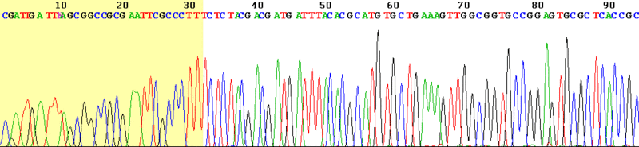
The reaction fragments (the fluorescent tagged fragments) are poured in a gel containing tube and electrophoresis is applied. The smallest fragment moves faster towards +ve end and read by the laser. The next larger fragment will follow it.
Laser excites the dye and the camera identifies the emitted color and hence the nucleotide
Computer
THERE ARE NEWER VARIANTS BUT THE CONCEPT IS THE SAME
Camera
Laser
Author: Loris; http://en.wikipedia.org/wiki/File:Sanger_sequencing_read_display.gif
Chromatogram

Slide 29
Sanger Sequencing
1979-2003 Dominant sequencing method
Can produce high quality reads
Error rate < 1% /base
Still used in large sequencing centers
Currently, can read 800 or more bases in one reaction

Slide 30
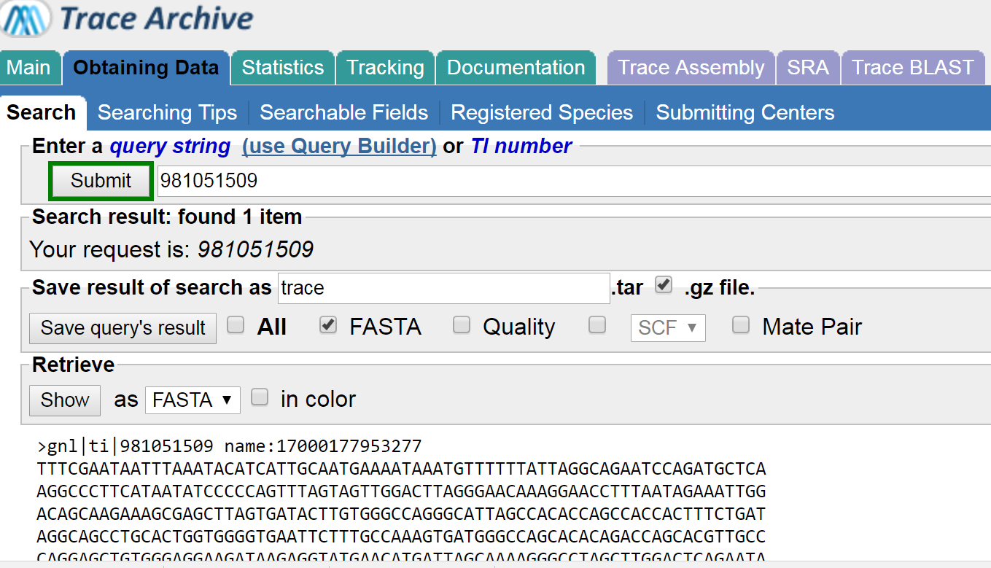
Sanger Sequencing
Sequencing read is called a trace
Sequences are stored in a database (NCBI) called Trace Archive
Ex 981051509
Let us take a different route to get here via BLAST

Slide 31
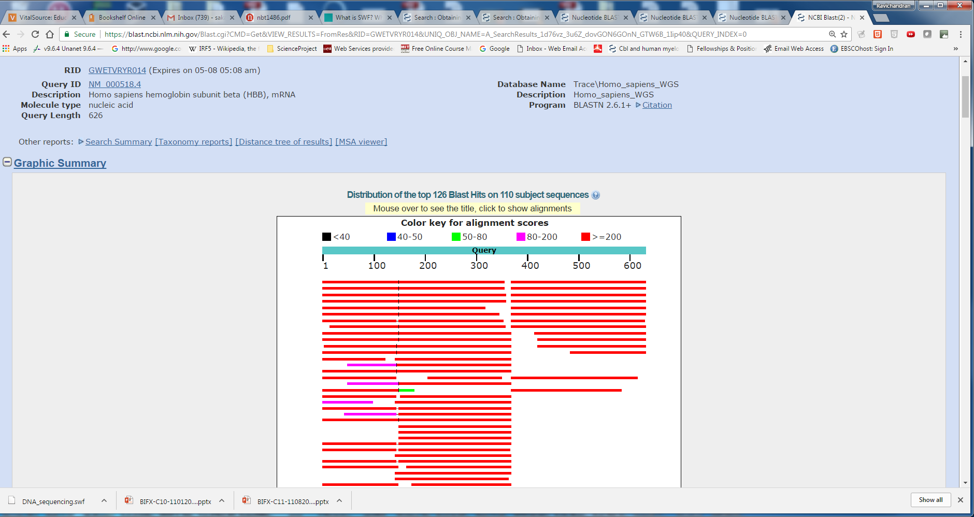
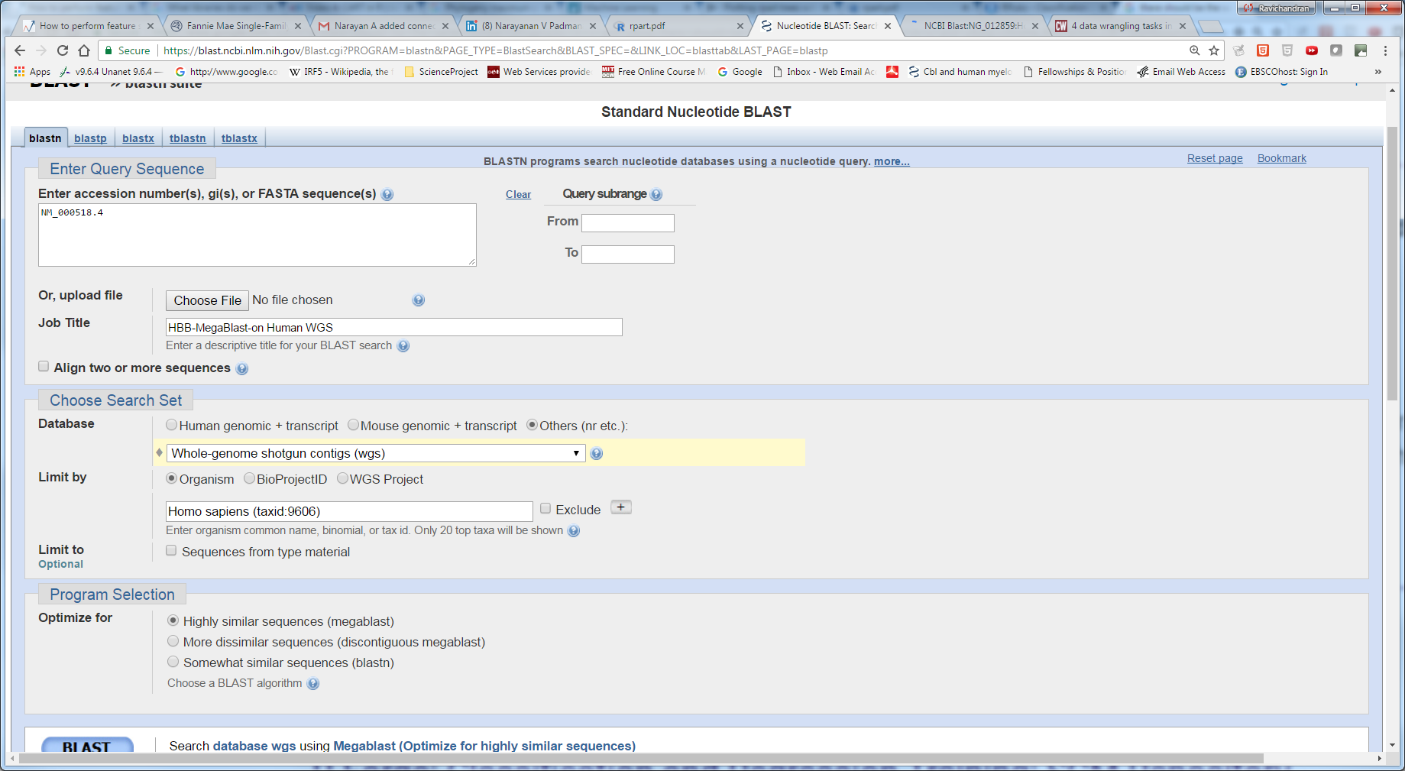
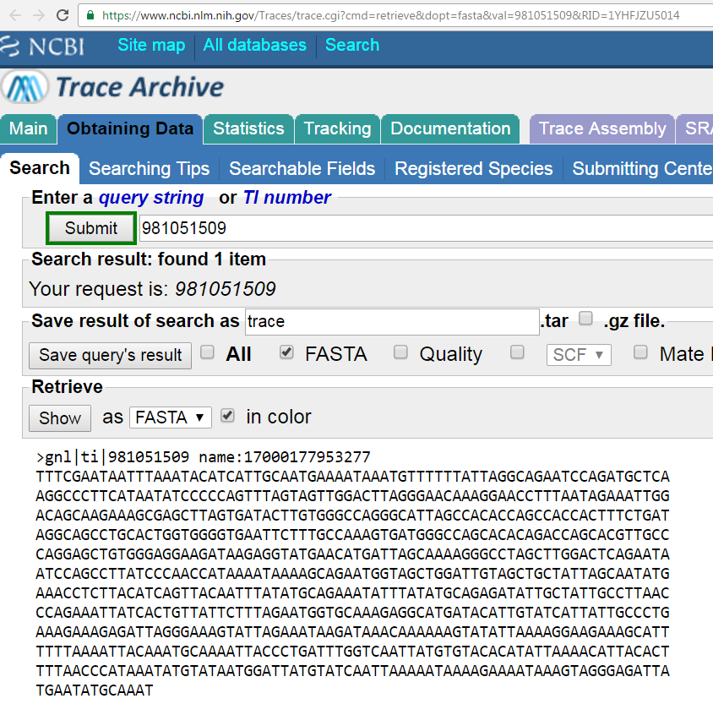
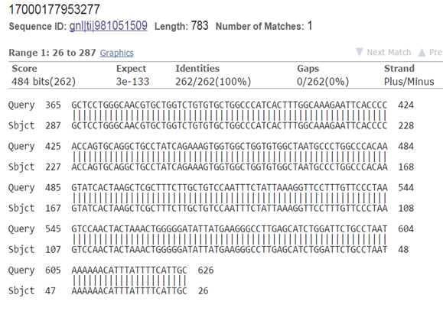
NM_000518.4
Human-WGS
MEGABLAST
Sample Trace Sequence
Alignment of SRA sequence to HBB

Slide 32
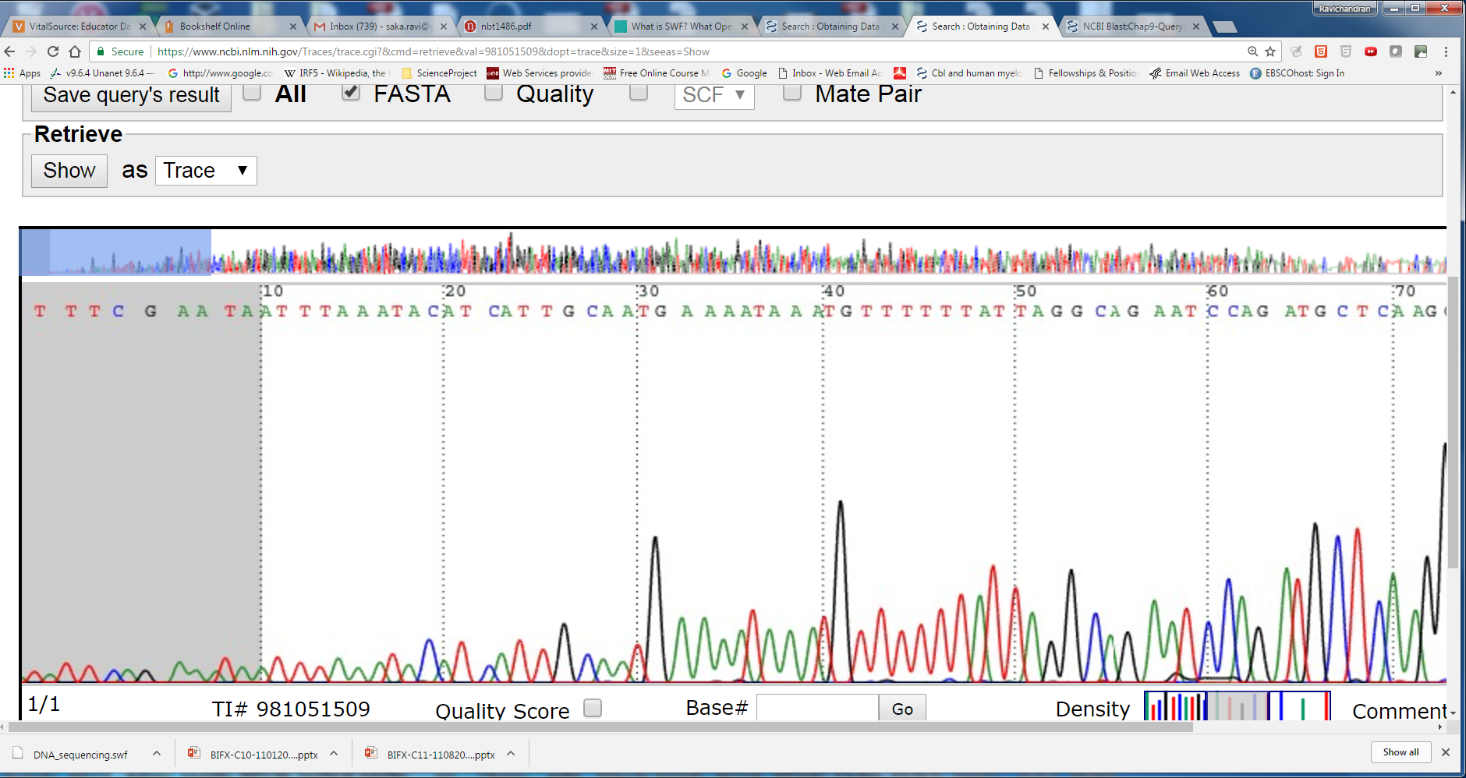
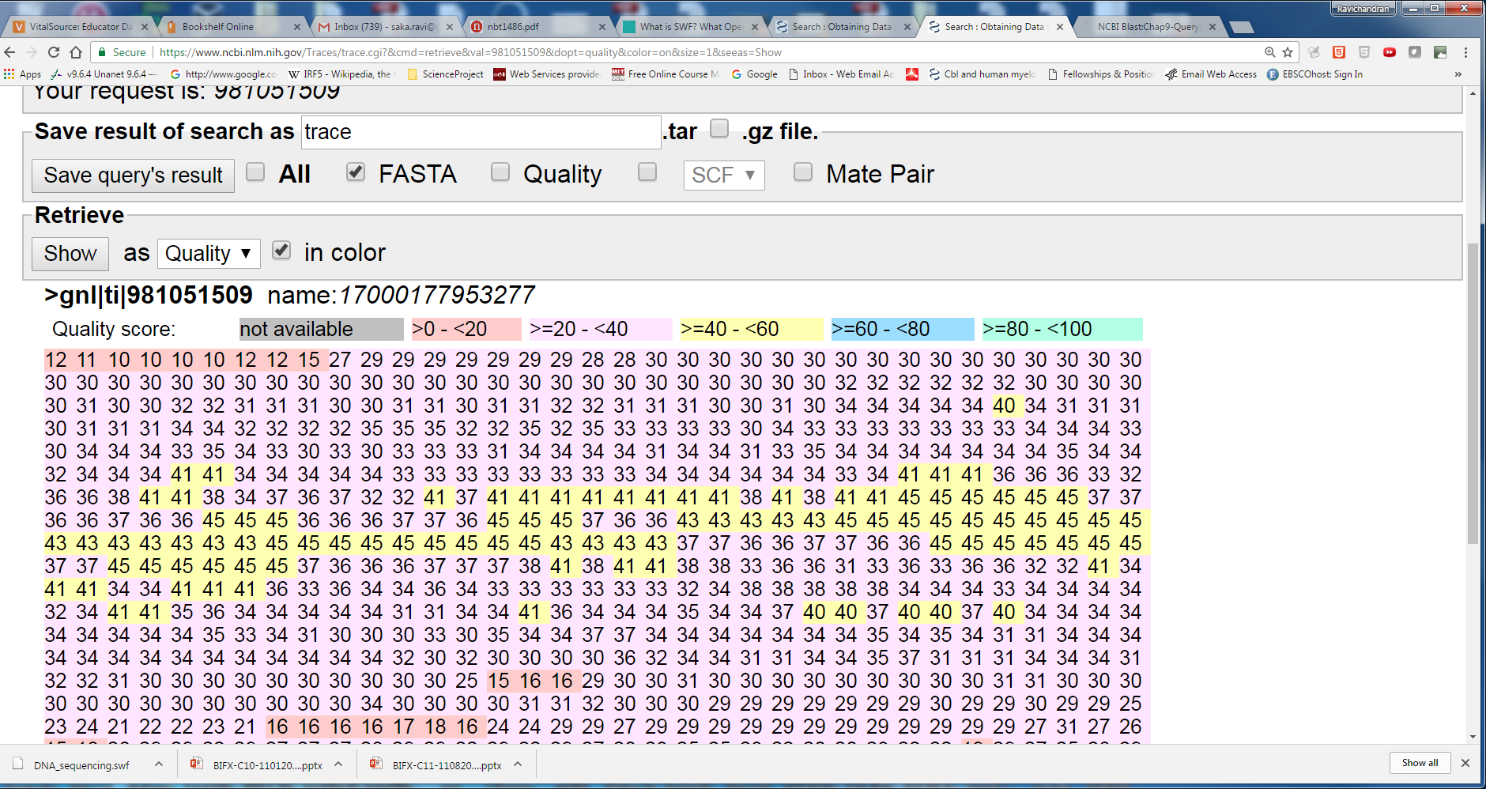
Phred score:
Q = -10 log₁₀ P
At a quality score of 20 (Q20) there is a
10^-2 or 1% error rate
Scores below Q20 are suspect

Slide 33
More on Phred Scores
Phred scores
Phred Quality Score Prob of incorrect base call Base call accuracy
10 1 in 10 90%
20 1 in 100 99%
60 1 in 1M 99.9999%

Slide 34
To understand the quality scores, we need to understand ASCII codes

Slide 35
Nucleotide Symbols
A, T, G, C
R = G/A (purine)
Y = C/T (Pyrimidine)
M = A/C
K = G/T
S = C/G
W = A/T
H = A/C/T not G
B = C/G/T not A
V = A/C/G not T
D = A/G/T not C
N = A/C/G/T

Slide 36
Scores
Three types of scores
Sanger standard format (commonly used)
Often called Q or PHRED scores
Introduced by Phil Green (1998)
Solexa (now Illumina Inc.) since 2004
Illumina 1.3+ FASTQ format

Slide 37
Let us focus on Standard Sanger Scores
Scores are stored as ASCII printable characters 33-126
ASCII offset of 33 (why 33-126, more on next page)
Range of possible quality score is 0-93
126-33 = 93

Slide 38
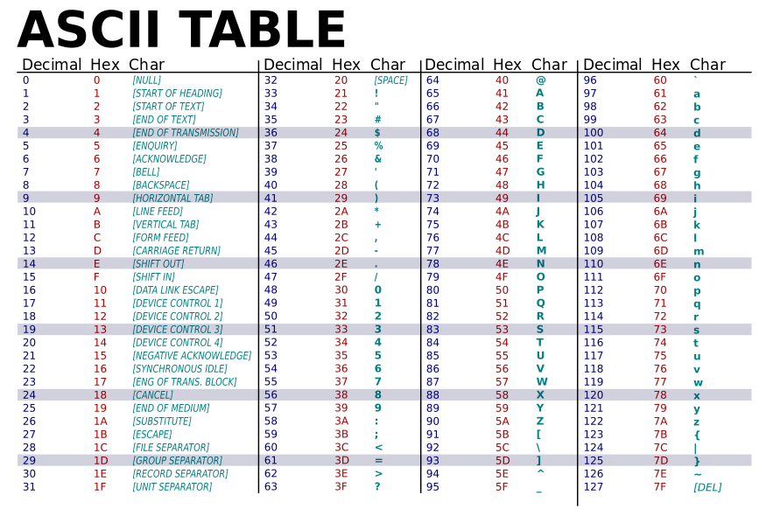
Public Domain Figure from http://simple.wikipedia.org/wiki/ASCII Author: LanoxxthShaddow (ASCII-Table.svg: ZZT32)

Slide 39
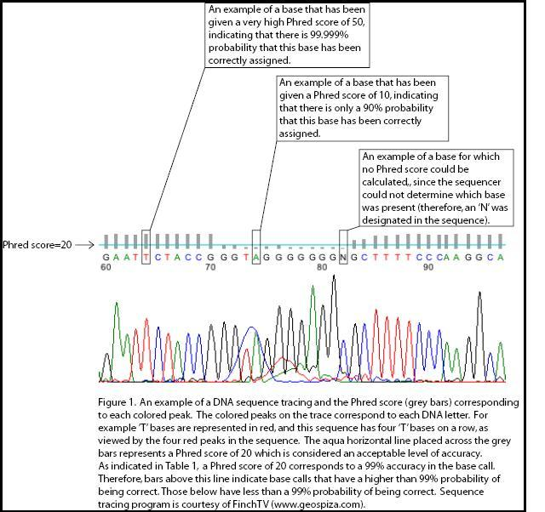
https://en.wikipedia.org/wiki/File:Phred_Figure_1.jpg
Author: Roseisis
Phred Quality Scores (Q) Error Probabilities (P)
For Q = 50,
P = 1/10^5 = 0.00001 Accuracy = 1 – 0.00001 = 99.999%

Slide 40
Phred Quality Score | Probability of incorrect base call | Base call accuracy
10 | 1 in 10 | 90%
20 | 1 in 100 | 99%
30 | 1 in 1000 | 99.9%
40 | 1 in 10,000 | 99.99%
50 | 1 in 100,000 | 99.999%
60 | 1 in 1,000,000 | 99.9999%

Slide 41
@SEQ_ID GATTTGGGGTTCAAAGCAGTATCGATCAAATAGTAAATCCATTTGTTCAACTCACAGTTT + !''*((((***+))%%%++)(%%%%).1***-+*''))**55CCF>>>>>>CCCCCCC65
FASTQ (ASCII format)
Line 4: quality values same number as line 2. Probability of error during the sequencing
Two types of quality summary standards are in common practice
Sanger (PHRED +33)
Subtract 33 from the numeric value associated with the ASCII character
@ Dec value of 64; so Q = 64 – 33 = 31
Solexa (PHRED +64)
Subtract 64 from the score
Q = 64 – 64 = 0
Q = -log₁₀P

Slide 42
@SEQ_ID GATTTGGGGTTCAAAGCAGTATCGATCAAATAGTAAATCCATTTGTTCAACTCACAGTTT + !''*((((***+))%%%++)(%%%%).1***-+*''))**55CCF>>>>>>CCCCCCC65
If PHRED SCORE Prob of incorrect base call Accuracy 0 1 in 1 0% 30 1 in 10 90%
Quality Scores: ‘!’ lowest and ‘~’ is the highest
If the symbol is ‘!’
QUIZ: What is the Quality score for the second base in the above read?
Assume Sanger Standard (PHRED +33) to get the Quality Scoring.

Slide 43
Quality Scores: ! Is for lowest and ~ is for the highest. Why these symbols were chosen?
Public Domain Figure from http://simple.wikipedia.org/wiki/ASCII Author: LanoxxthShaddow (ASCII-Table.svg: ZZT32)
ASCII code for ‘!’ is 33 so Q(Sanger) = 0; Q(Solexa) = 33 – 64 = -31
ASCII code for ‘~’ is 126

Slide 44
@SEQ_ID GATTTGGGGTTCAAAGCAGTATCGATCAAATAGTAAATCCATTTGTTCAACTCACAGTTT + !''*((((***+))%%%++)(%%%%).1***-+*''))**55CCF>>>>>>CCCCCCC65
FASTQ (ASCII format)
Line 4: quality values same number as line 1. Probability of error during the sequencing
FASTG is an extension of FASTQ
Qsanger = -10 log10 P and QSolexa = -10 log10 p/1-p

Slide 45
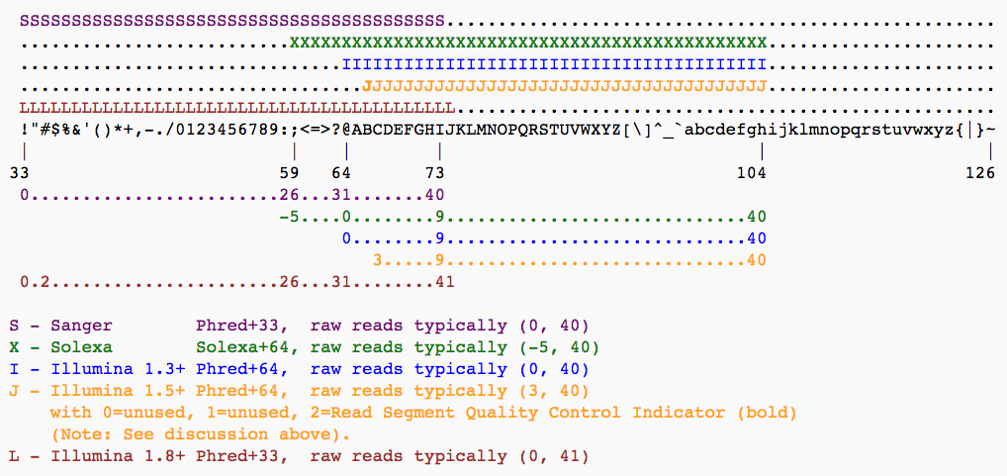
Image was taken from Galaxy.org site Starting with Illumina 1.8

Slide 46
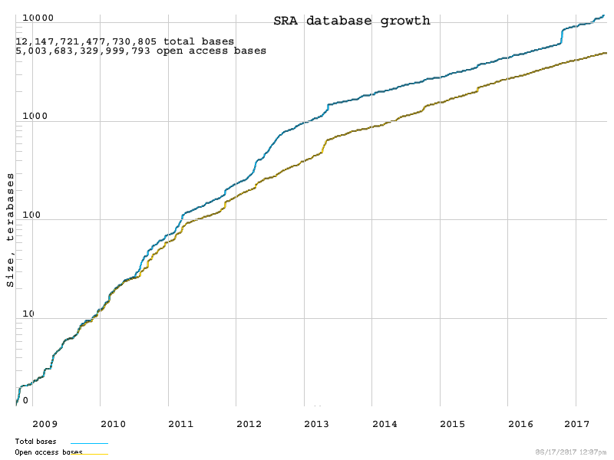
FastQ files, is there a DB?
SRA from NCBI
stores FASTQ files
Total Bases
Open access Bases
~ 5 Million Billion or ~ 5 Quadrillion

Slide 47
Compare Sanger with NGS Sequencing

Slide 48
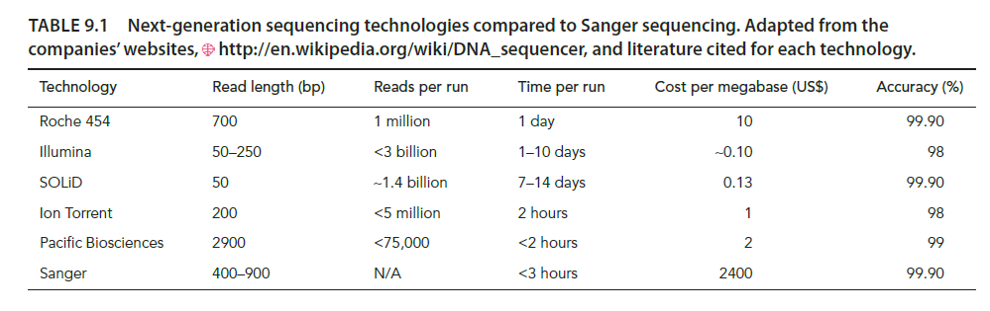
Table 9.1 from the Book

Slide 49
Watch the Video in the class
https://www.youtube.com/watch?annotation_id=annotation_228575861&feature=iv&src_vid=womKfikWlxM&v=fCd6B5HRaZ8

Slide 50
Other Sequencing Methods
Pyrosequencing
Alternative approach to Illumina
Uses a Bead based approach instead of a “flow cell”
Sequencing by Ligation
Library preparation
Bead coupling → PCR amplification
Bead deposition on glass slide
Sequencing by ligation
Data Analysis (repeat steps 1 to 5 many times)

Slide 51
Next Gen Seq. technology: Applications
1000 Genomes Project
HEP
How do go from sequence reads to applications?
Step1 answers the question for each read,
where does this read came from?

Slide 52
NGS Application: Variant Detection
READS
READS
READS
GTCGCAGTANCTGTCT |||||||||||||||| GTCGCAGTATCTGTCT
Pile-up:
The collection of NTs from each read at a particular location
Align to the Reference
GGATCTGCGATATACC ||||||||||||||||
GGATCT-CGATATACC
Aggregate/Pile-up
TCTCTCCCANNAGAGC ||||||||||||||||
TCTCTCCCAGGAGAGC
Statistics

Slide 53
NGS Application: RNA-seq differential expression (RNA not DNA)
Take RNA→ cDNA and sequence them
Sample A
Reads
Aggregate
Align
Pile-up
GeneX
Reference
CTCTGGTCGAGGGTCTAAATCGCCCCTGTGTACCCGGGTAGAGAGAGACCAG
Sample B
Reads
Align
Aggregate
Statistics
Pile-up
GeneX is expressed more in Sample A than B

Slide 54
Analysis of NGS of Genomic DNA

Slide 55
Commonly used workflow is the Genome Analysis Toolkit (GATK)

Slide 56
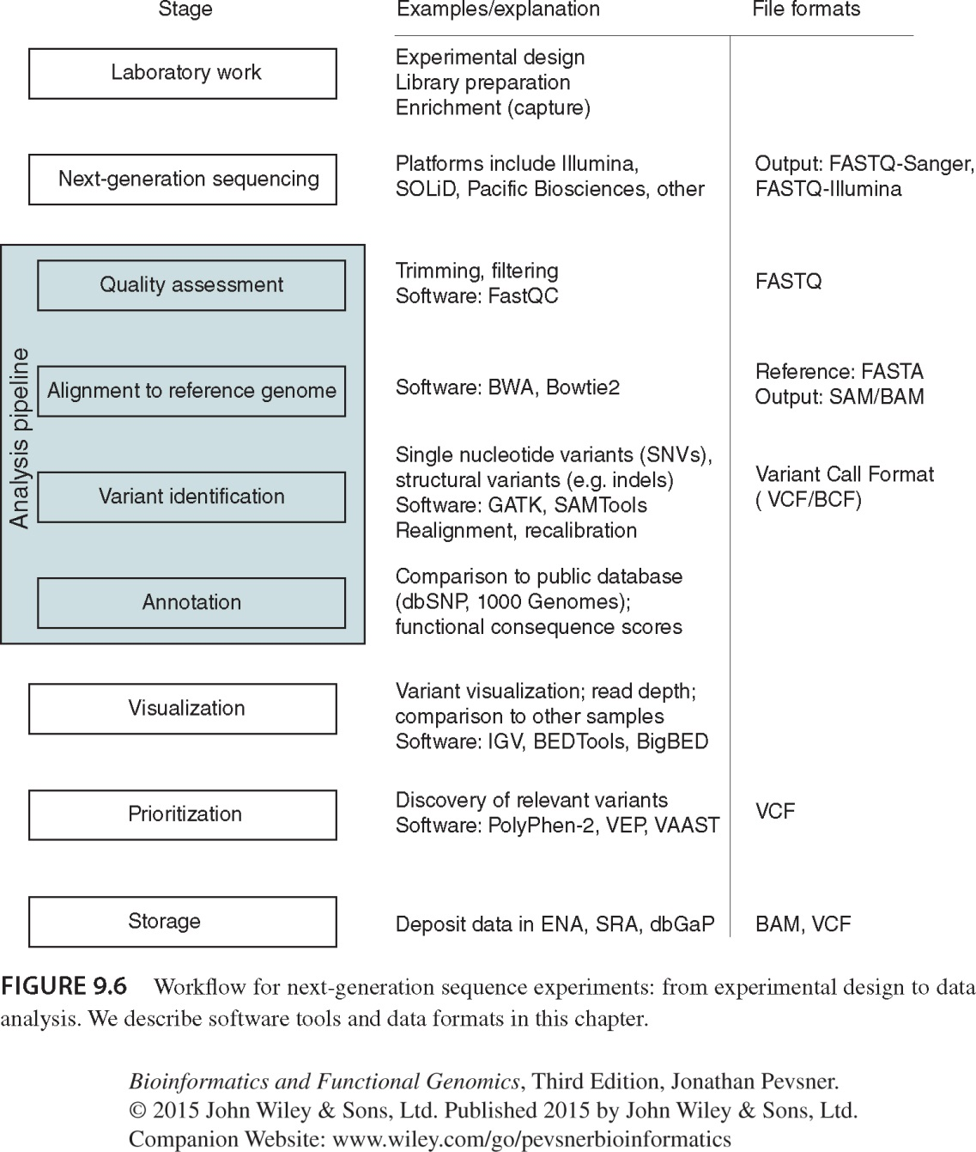
FASTQ-Sanger/ FASTQ-Illumina
SAM/BAM
VCF/BCF

Slide 57
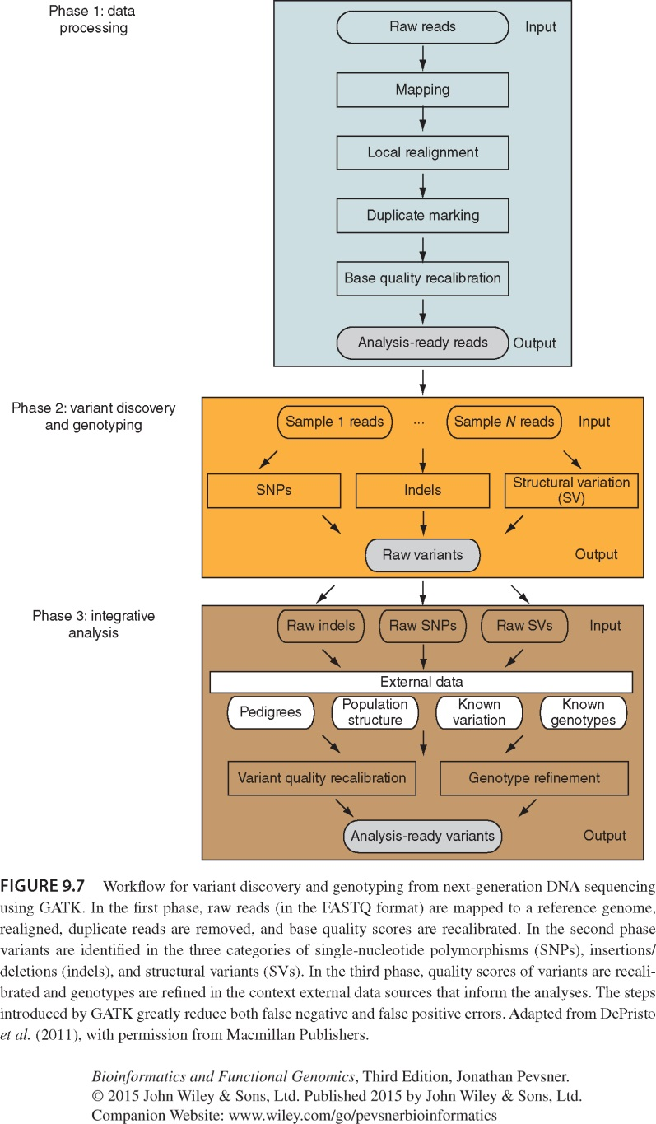
GATK: Genome Analysis Toolkit state-of-the-art workflow

Slide 58
FASTQ (Sanger to NextGen)
@SEQ_ID GATTTGGGGTTCAAAGCAGTATCGATCAAATAGTAAATCCATTTGTTCAACTCACAGTTT + !''*((((***+))%%%++)(%%%%).1***-+*''))**55CCF>>>>>>CCCCCCC65
ASCII format
Line 1: begins @ character and other details (sequence ID etc) are optional
Line 2: raw sequence of the read
Line 3: begins with “+” and optionally by same sequence ID

Slide 59
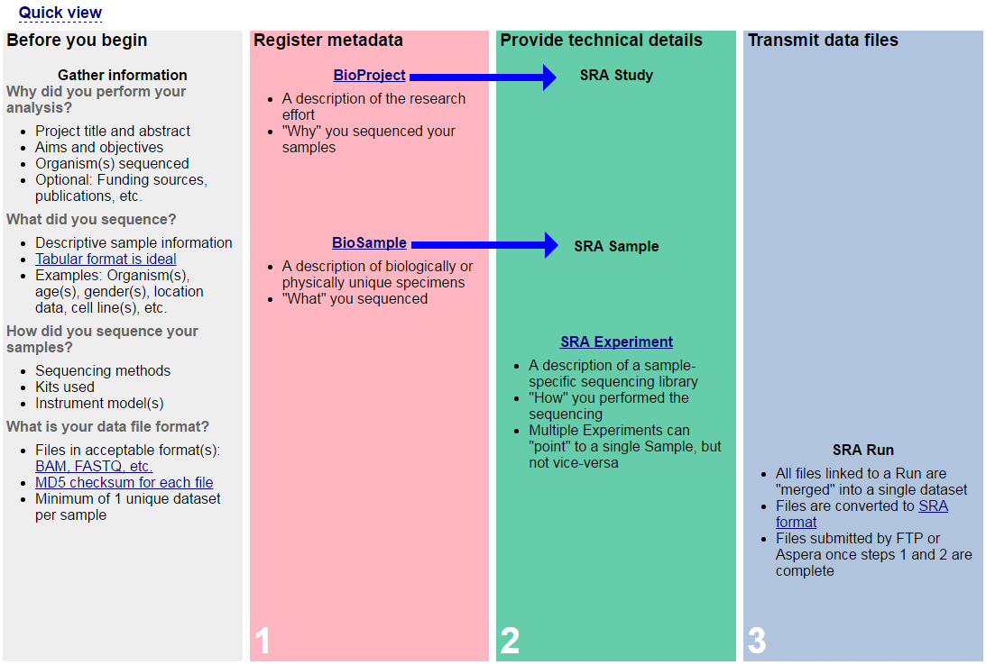

Slide 60
6. SAMTOOLS -SAM/BAM
BAM is just the binary version of SAM. So, we will just focus on SAM
What is a SAM file? Sequence Alignment Map file (read to reference) of NextGen data
How do we view or analyze the read aligned file?
SAMTools package can be used to view, convert BAM ←→ SAM, view alignments etc.

Slide 61
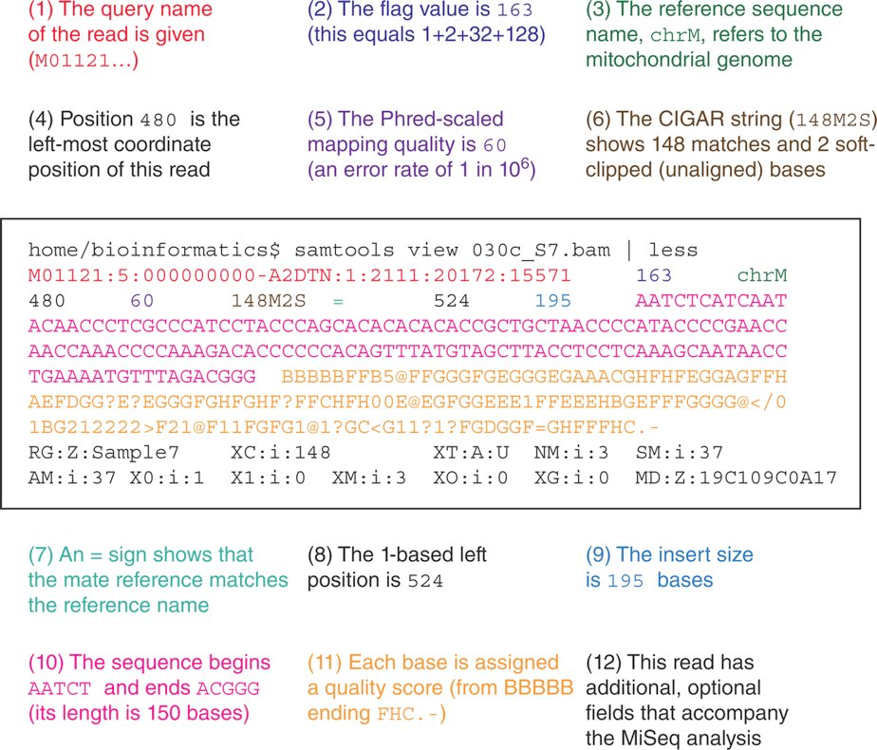
SAM File

Slide 62
Variant File

Slide 63
Flag file 1+2+32+128
000000000001 : 1 : read paired
000000000010 : 2 : read mapped in proper pair
000000000100 : 4 : read unmapped
000000001000 : 8 : mate unmapped
000000010000 : 16 : read reverse strand
000000100000 : 32 : mate reverse strand
000001000000 : 64 : first in pair
000010000000 : 128 : second in pair
000100000000 : 256 : not primary alignment
001000000000 : 512 : read fails platform/vendor quality checks
010000000000 : 1024 : read is PCR or optical duplicate
100000000000 : 2048 : supplementary alignment

Slide 64
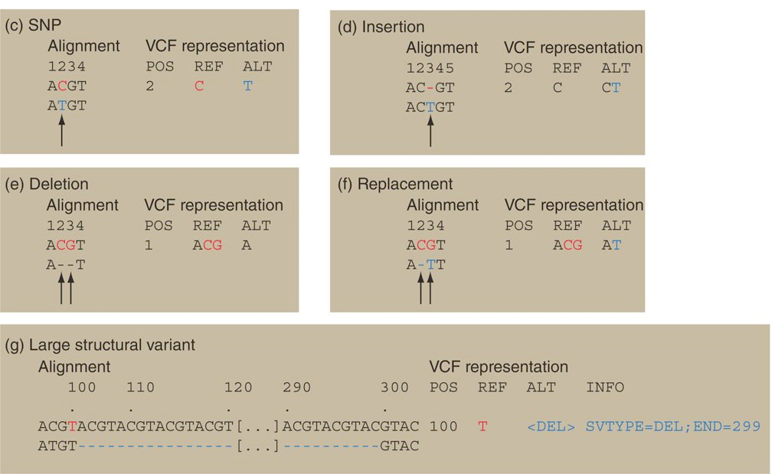

Slide 65
VCF File and what we can do with it?
Most software require a compressed VCF
So, we can compress them using Linux command and feed them as input

Slide 66
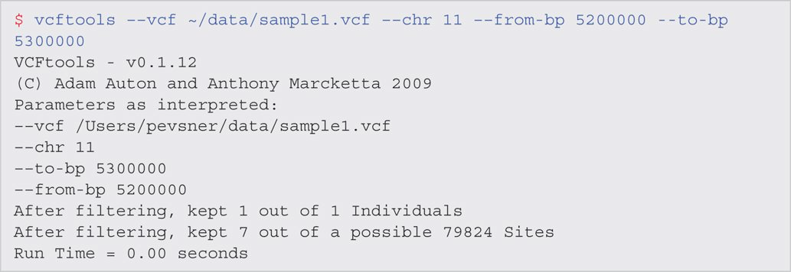
We can get stats (depth coverage etc.)
For example, using the VCF, we can ask in Chromosome 11, from mbp 5200,000 – 5,300,000 what are the variations?
This is the Beta Globin Region

Slide 67
Coverage

Slide 68
Where can we find VCF files?
1000 Genomes
Example 1
Go to ENA site
Search for ERZ015345
Send the vcf to galaxy or download
Example 2
Go to NCBI
ftp://ftp.ncbi.nih.gov/snp/organisms/human_9606/VCF/

Slide 69
How to visualize the variant files
SamTools and IGV are good software for visualizing the HGV data
gwbench

Slide 70
After Class Work
Complete the Self-test Quiz
The following are the assigned Problems/Computer Lab for this week:
9-2, 9-3
The following questions is not part of the book computer lab set
Use NA12878 or other NGS data and use a gene of your interest and do a SRA-blast

